Slide 1
Training Notebook
Titan Portal
Yizhou wang
01/22/2021

Slide 2

Titan Server Portal (http://10.220.239.17/main_genomics.html)
Available Module
Demultiplexing
NextSeq500
MiSeq
NovaSeq6000
10X scRNA-seq data processing
Mapping
Results summary
Reanalyze
Aggregation analysis
Sequencing stats summary
“click button” for wet lab
Sample sheet backup
Location specificed
Email notification
Demultiplexing stats summary
Scripts for running on HPC
Urgent jobs running on titan
Email notification

Slide 3
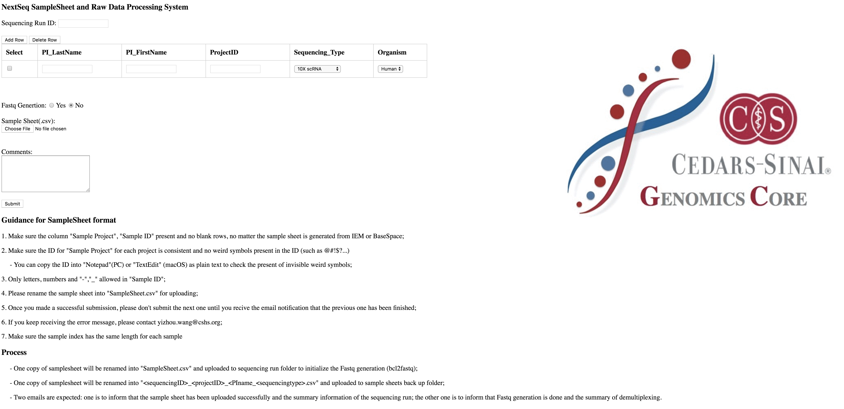

Slide 4
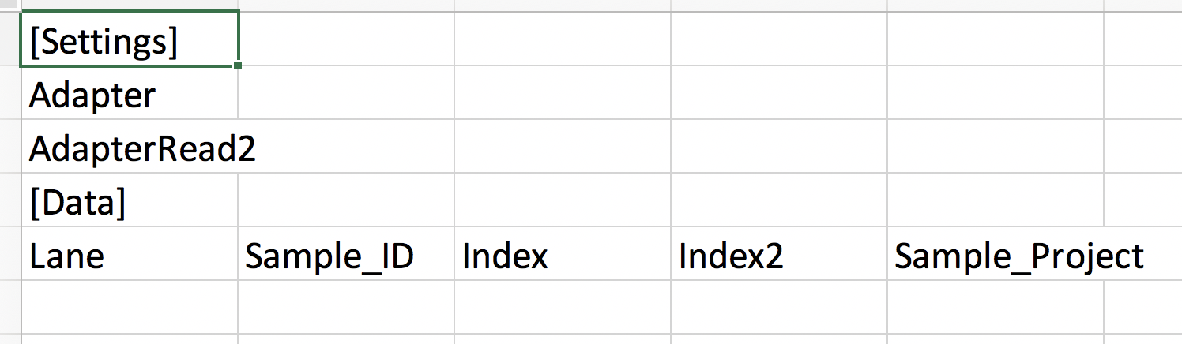
Uniform sample sheet format
Information needed:
Adapter sequences
Lane
Sample_ID (required)
Index (required)
Index2
Sample_Project (required)
Leave the form blank if you don’t have the information

Slide 5
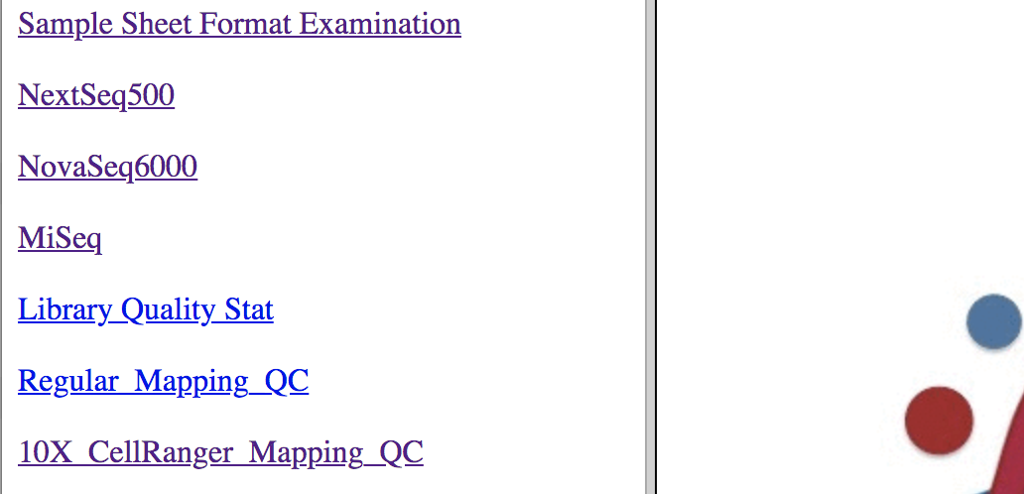
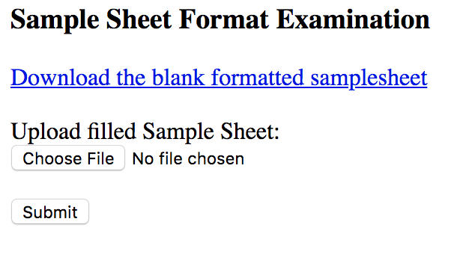
Check sample sheet format
Only keep letters, numbers and “-”,”_”
Check format
Check duplicated indexes

Slide 6
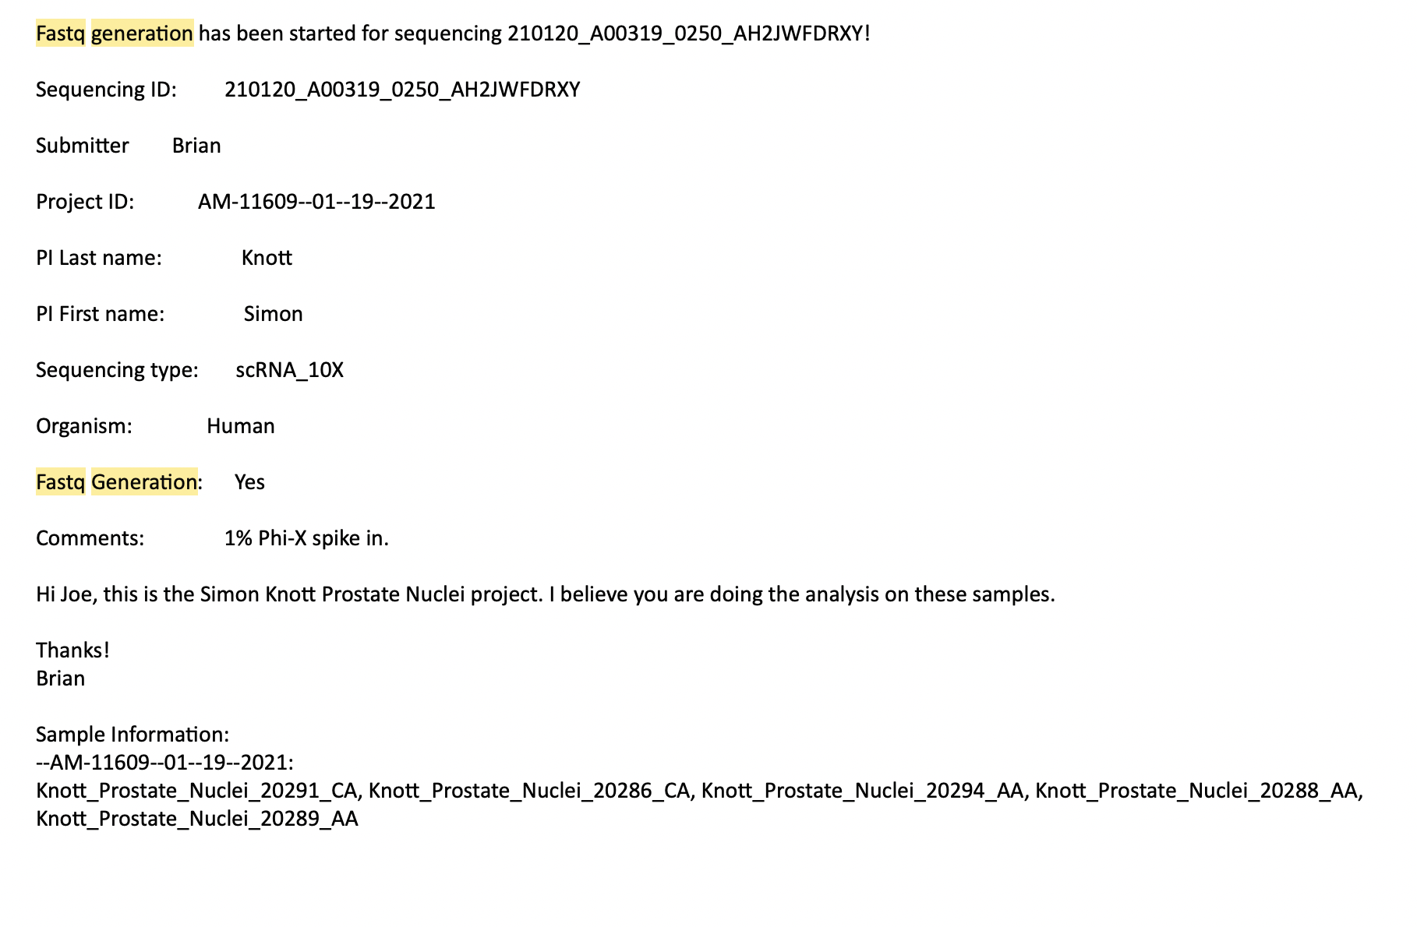
Email notification when demultiplexing start

Slide 7
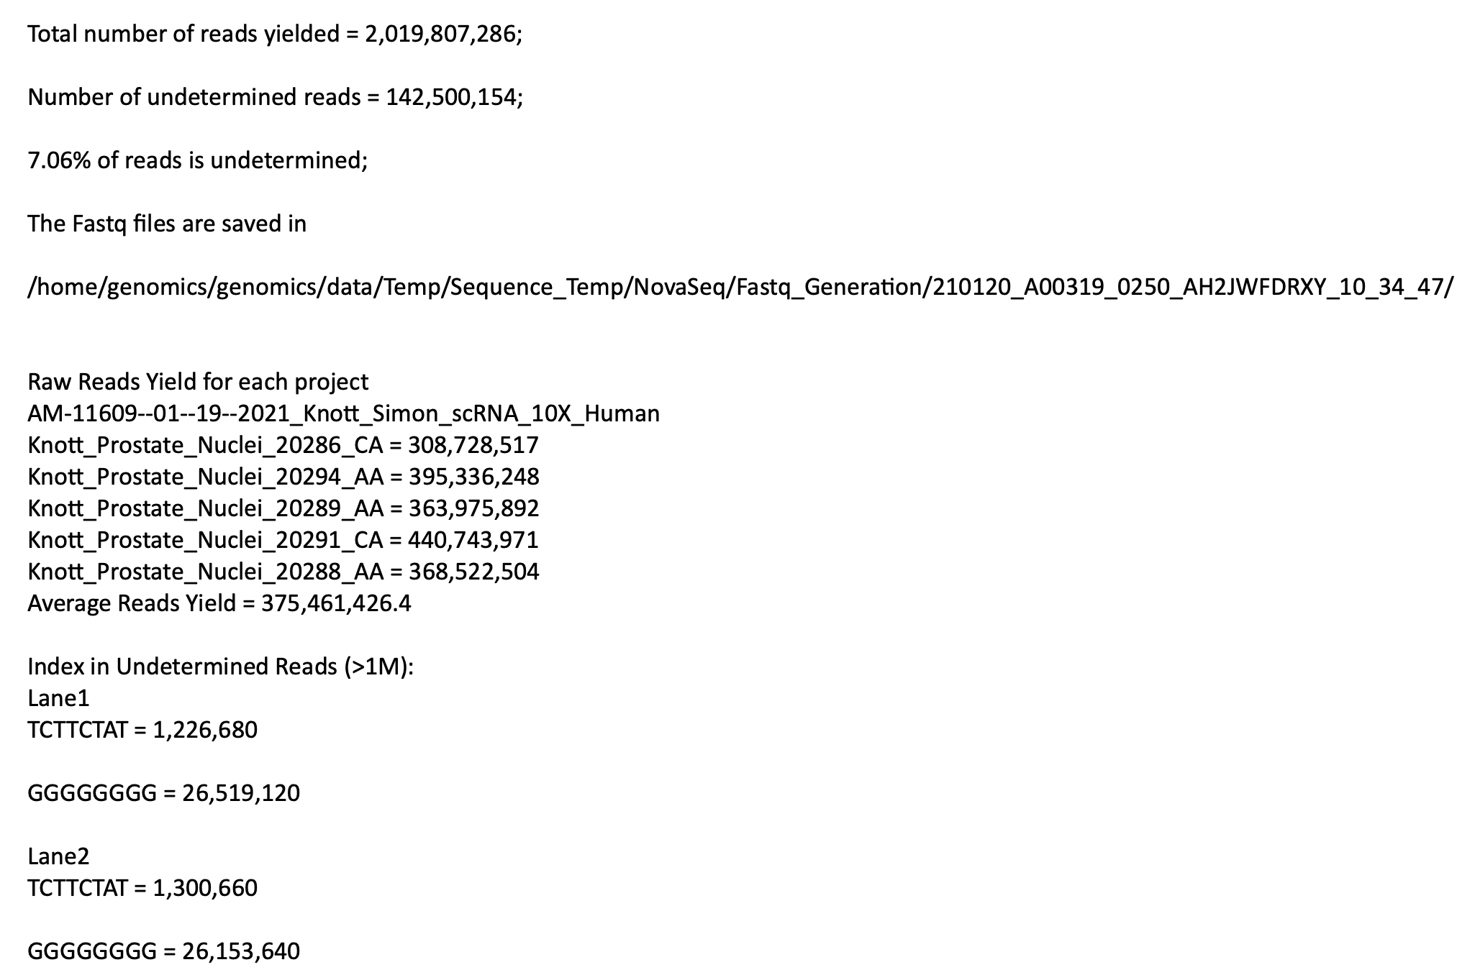
Email notification when demultiplexing is done
Usually, the number should be around 5 – 10%.
Path for FASTQ files on TITAN server
Reads yield for each sample and average reads yield. We have promise of minimum average reads yield for some sequencing services (e.g. mRNA-seq, totalRNA-seq)
Important for diagnosis of wrong index sequences provided

Slide 8
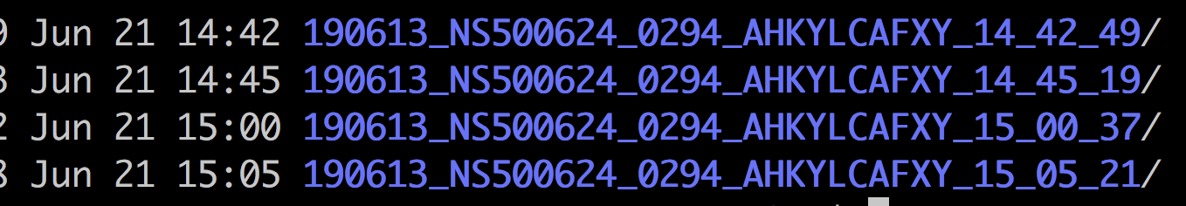
Use time stamp to distinguish multiple demultiplexing from the same sequencing run

Slide 9
Collaboration between wet & dry lab
Download and fill the blank formatted sample sheet
Run Tier1 data processing pipeline
Check reads yield and indexes in undetermined reads
Wet Lab
Check the format and duplicated indexes for samplesheet
Generate deliverables and check results (Yizhou, Chintda)
Dry lab
Run demultiplexing
If error
Fill the project information on titan server
Deliver the data and results to customers
Email from titan
Email from wet lab
Email from dry lab

Slide 10
Error reported from demultiplexing
Email notification with detailed error message
Example:
Error Message:
2019-06-21 14:24:13 [f18880] INFO: FASTQ compression level: 4
2019-06-21 14:24:13 [f18880] INFO: RunInfo.xml: '"/home/genomics/genomics-archive/NovaSeq_RawData/190614_NS500624_0295_AHKF5FAFXY/RunInfo.xml"'
2019-06-21 14:24:13 [f18880] ERROR: bcl2fastq::common::Exception: 2019-Jun-21 14:24:13: No such file or directory (2): /TeamCityBuildAgent/work/556afd631a5b66d8/src/cxx/lib/io/Xml.cpp(201): Throw in function boost::property_tree::ptree bcl2fastq::io::parseXmlFile(const boost::filesystem::path&)
Dynamic exception type: boost::exception_detail::clone_impl<bcl2fastq::common::IoError>
std::exception::what: Unable to open '/home/genomics/genomics-archive/NovaSeq_RawData/190614_NS500624_0295_AHKF5FAFXY/RunInfo.xml' file for reading

Slide 11
Error from demultiplexing…
Dry lab will check the errors first, then send the email to web lab to explain the issue;
If it is human mistakes (wrong sequencer selected, incorrect sequencing ID, wrong sample sheet, etc.,), wet lab will redo the submission
If it is computational errors (# of mismatches in indexes, etc., ), dry lab will redo the submission.

Slide 12
Others
Titan Server access: https://cedars.app.box.com/file/109438517110?s=xi76ck9fu0koiuwvrolbg1u7ecf2fuiz
One demultiplexing at one time
Wet lab will reply to the email of the demultiplexing results to tell if proceed or not
For 10X data, we use CellRanger/SpaceRanger mkfastq to demutiplex; for other types of data, we use bcl2fastq
Access raw sequencing data folders from TITAN:
/home/genomics/genomics-archive2/Genomics/NovaSeq_RawData
Successfully submitted samples sheets are backed up for three sequencers respectively
/common/genomics-core/smb/raw/Genomics/NovaSeq_RawData/SampleSheets_NovaSeq (Novaseq)
/common/genomics-core/smb/raw/Genomics/NextSeq500_RawData/SampleSheets_NextSeq (Nextseq)
/common/genomics-core/smb/raw/Genomics/MiSeq_RawData/SampleSheets_MiSeq (Miseq)

